Slide 1

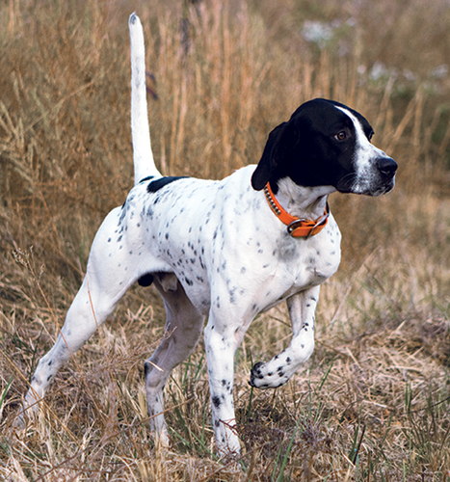
Bird Dog Review
August 27, 2025

Slide 2
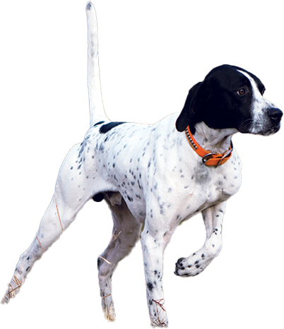
Agenda
What is Bird Dog?
Demo
Current Status
Next Steps Discussion

Slide 3
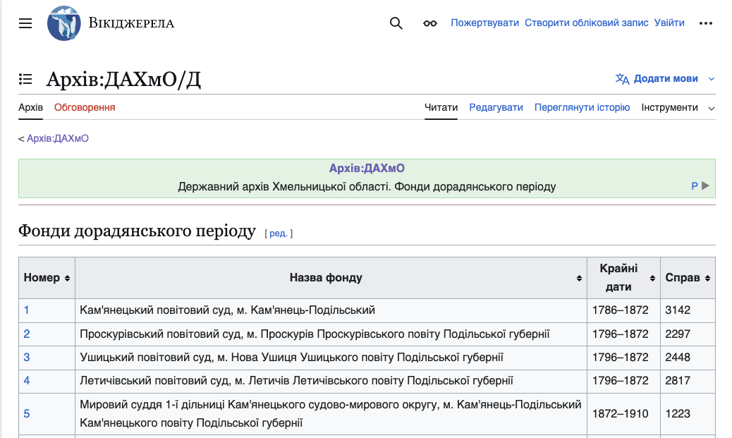

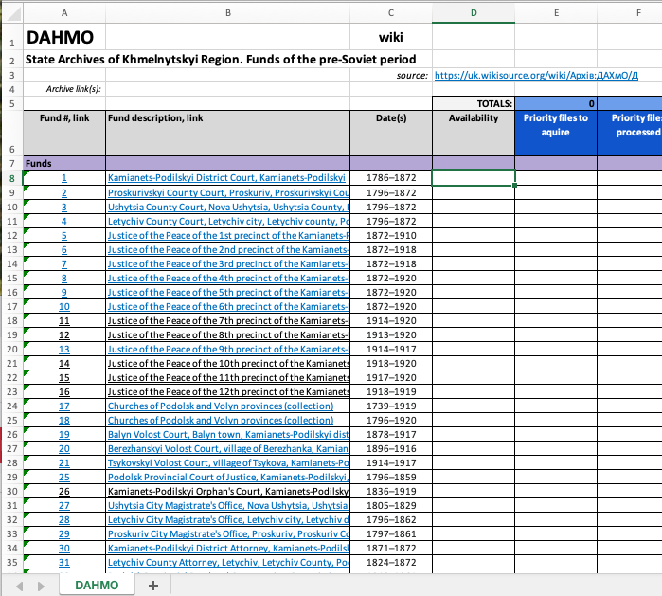
Existing Administrator Workflow
10,000+ changes per month
Overwhelming email notifications
😰
https://uk.wikisource.org
Copy/paste by the 100’s or 1,000’s
150,000+ pages to track

Slide 4
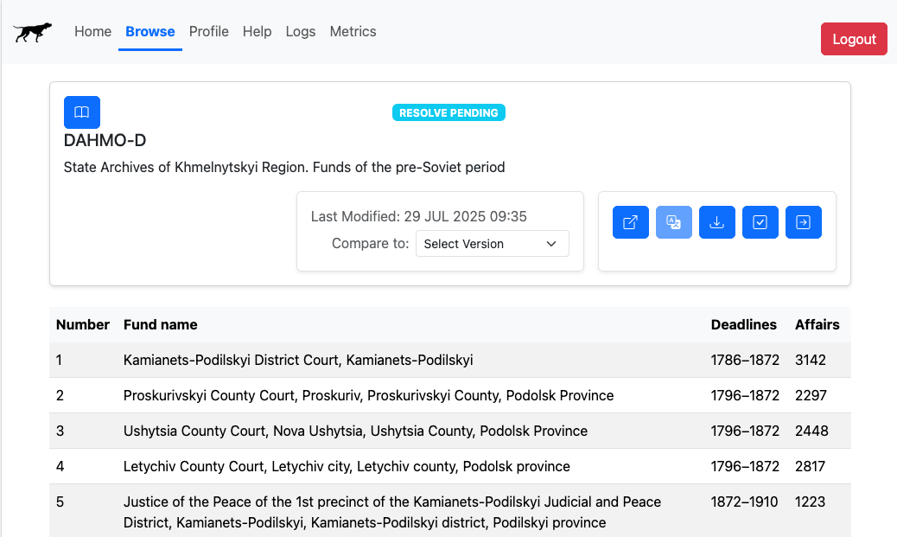
Birddog-Assisted Workflow
Built-in translation
😊
Automated spreadsheet generation
Streamlined change review
Consolidated change alerts

Slide 5
Timeline / Origin Story
Genesis from a set of standalone Python scripts to scrape the Wikidata archive pages and generate corresponding spreadsheets
Proposed the project (to Juliana and Gary) and started development
Initial deployment to AWS
“Alpha” period to complete initial feature set, with extensive help from Juliana
2023-24:
April 2025:
May 2025:
May-August 2025:

Slide 6
Bird Dog Features

Slide 7
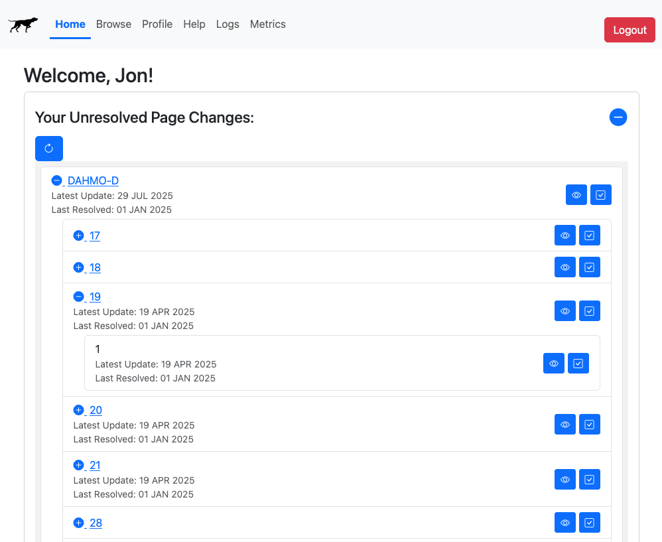
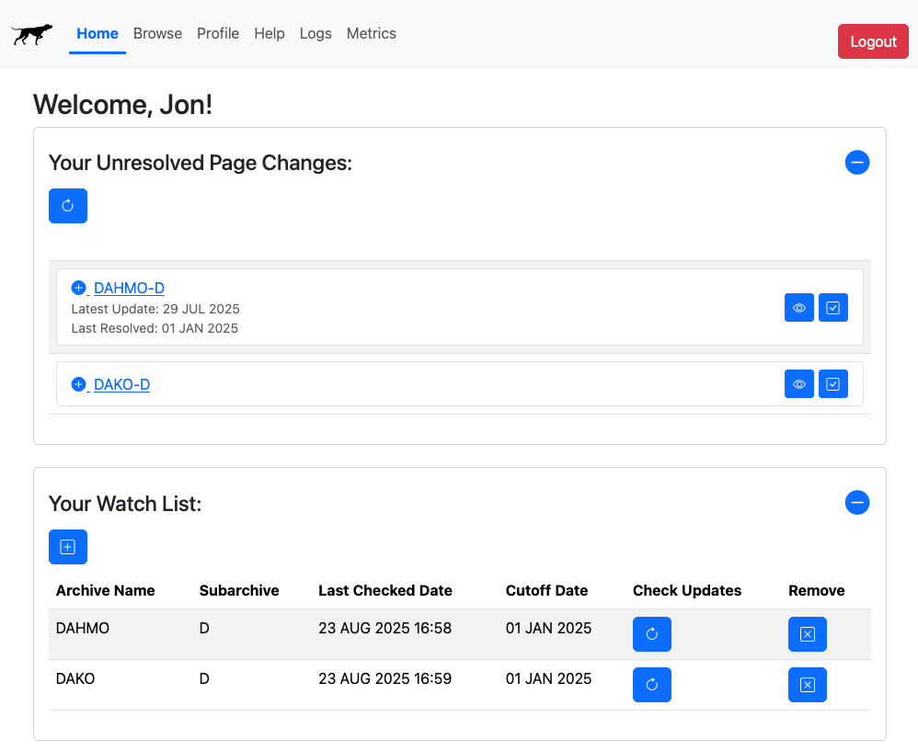
Bird Dog Features
Automated Wiki page change monitoring and reporting

Slide 8
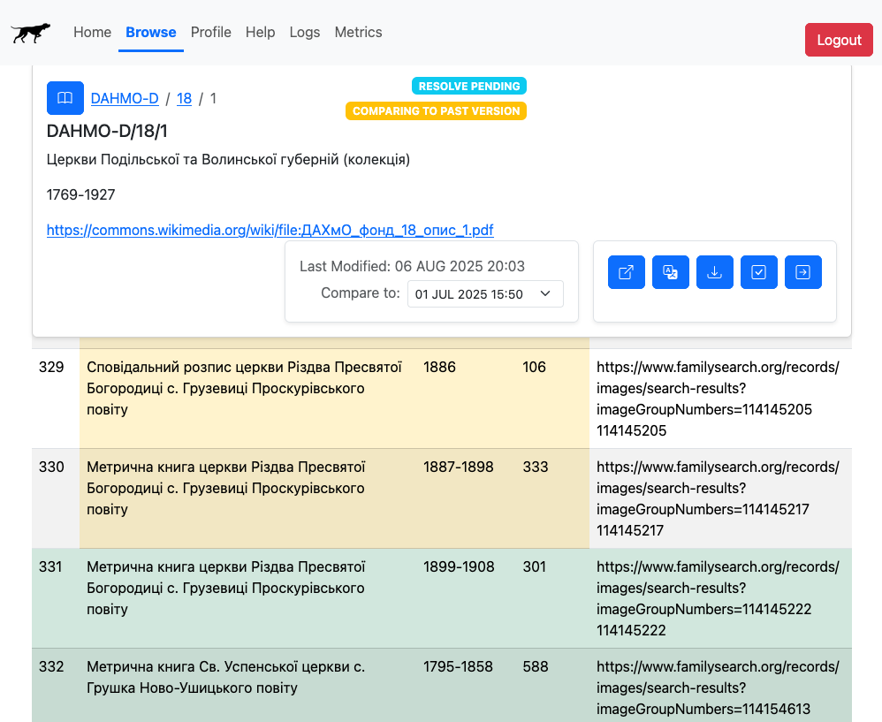
Bird Dog Features
Page change inspector in an easily digestible format
Text changes shown in yellow
Text additions shown in green

Slide 9
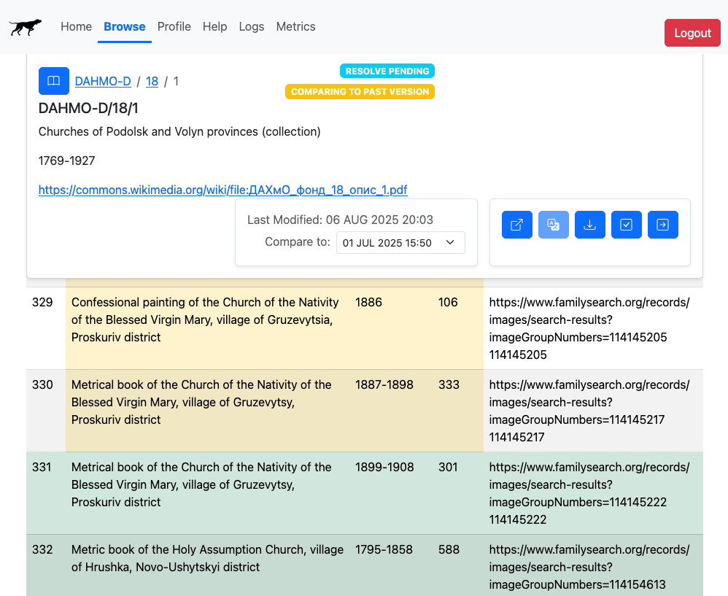
Bird Dog Features
Built-in Ukranian to English translation

Slide 10
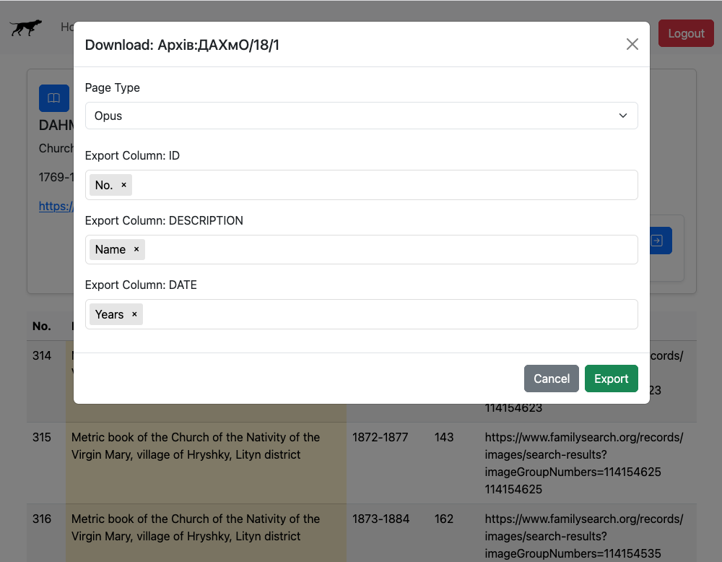
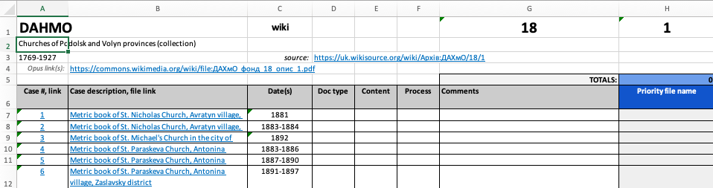
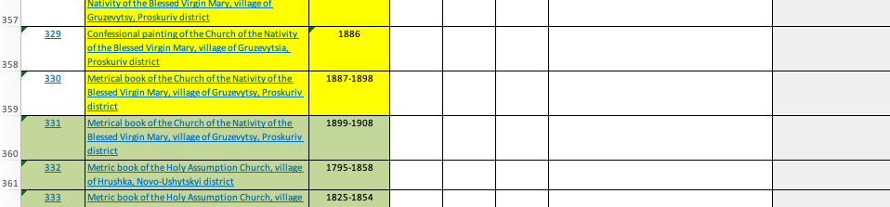
Bird Dog Features
Streamlined, yet controllable spreadsheet generation

Slide 11
Demo

Slide 12
Tech Platform and Architecture
AWS Elastic Beanstalk
Flask Server (Python)
Web Client
(HTML/JS)
Google Cloud Translate
uk.wikisource.org
API
Bootstrap UI Framework
S3 (Storage)
DynamoDB (NoSQL database)

Slide 13
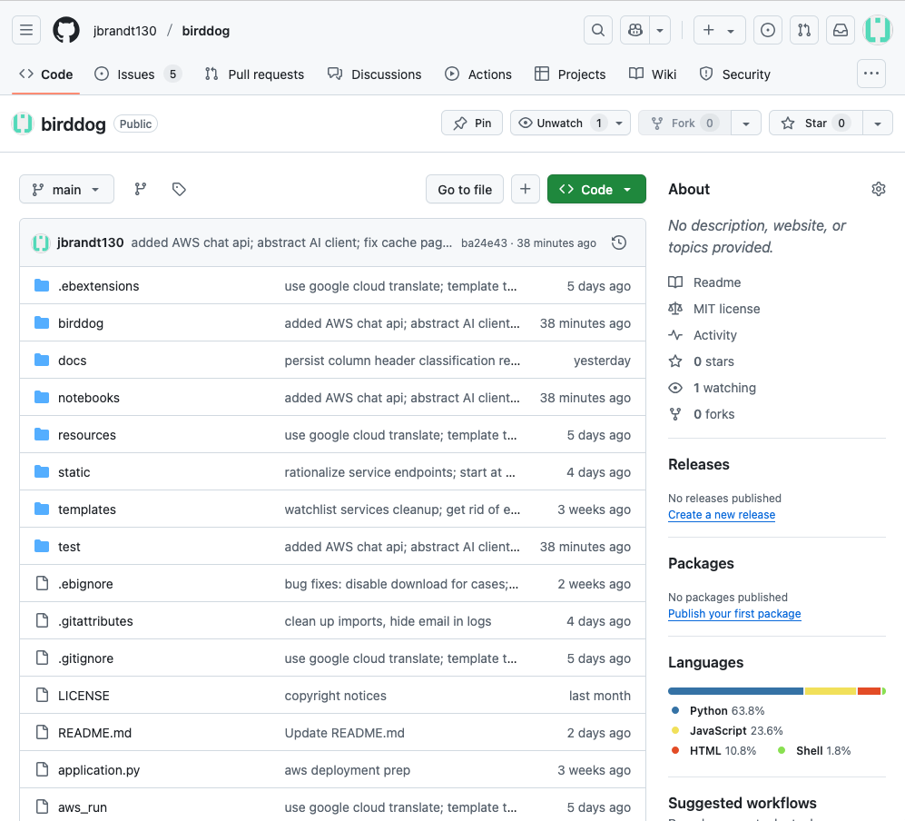
Open-Source Code Repo

Slide 14
Challenges and Limitations
No team
Poised, but not ready to be scaled to lots of concurrent users
Wiki API throttling
Variability of people-generated content (i.e. the wiki pages)
Google translate challenges (cost and not always accurate)

Slide 15
Possible Futures
Maintain
Scale
Extend
Migrate Birddog into JewishGen IT Infrastructure
Code maintenance / bug fixing
Documentation update
Cover operation costs: ~$50/month
Skills required: Python, Javascript, AWS
App hardening
AWS scale-out
Acquire wikidata API approval
Ongoing maintenance
Increased costs proportional to usage
Skills required: Python, Javascript, AWS, devops
Sync with Google Sheets
AI-assisted document prioritization, etc.
Align with JewishGen unified database project
Apply to other efforts in JewishGen
…

Slide 16

Discussion: Birddog’s Future

